Slide 1

Nội dung
Security PHP Web Application
- Cross-site scripting xss
- Cross-Site Request Forgery or CSRF

Slide 2
Security PHP Web Application - XSS
Cross-site scripting is the unintended execution of remote code by a web client
If input includes HTML or JavaScript, remote code can be executed when this content is rendered by the web client.

Slide 3



Security PHP Web Application

Slide 4

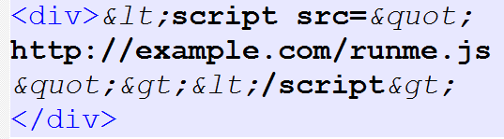
Security PHP Web Application Solution - HTML Encoding, URL Encoding

Slide 5
Security PHP Web Application - CSRF
Cross-Site Request Forgery or CSRF can force an end user to unknowingly generate malicious requests to a web server.
This attack vector can be exploited in both POST and GET requests

Slide 6
Security PHP Web Application - CSRF
Now if an authenticated user will encounter the following script in any other application
User Click bit.ly/my-link (domain.com/admin.php/delete.php?id=999)
Delete account

Slide 7
Security PHP Web Application - CSRF - Solution
A common solution to this problem is the use of CSRF tokens. CSRF tokens are embedded into requests so that a web application can trust that a request came from an expected source as part of the application's normal workflow

Slide 8
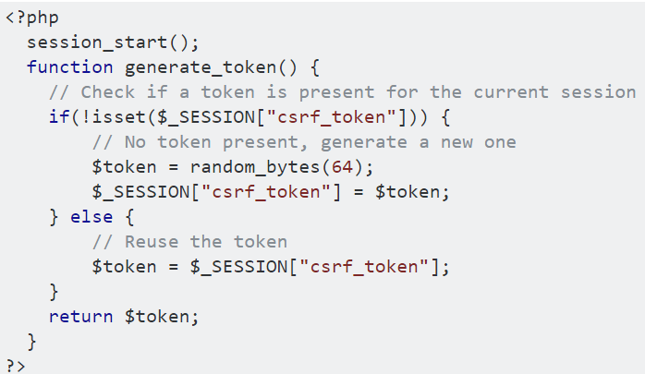
Security PHP Web Application - CSRF - Solution

Slide 9
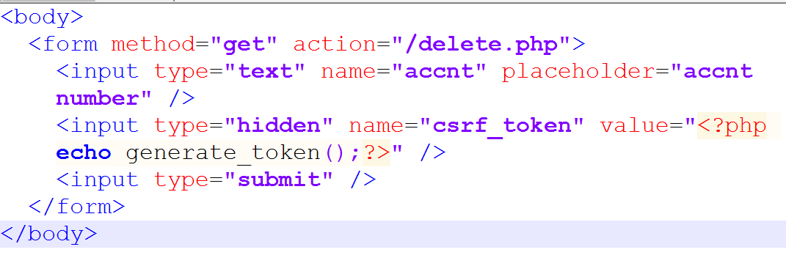
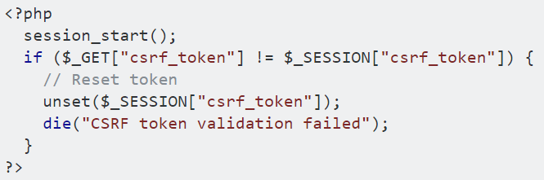
Security PHP Web Application - CSRF - Solution

